Slide 1


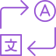


Develop in one language deliver to many b
POLYGLOTBOT

Slide 2
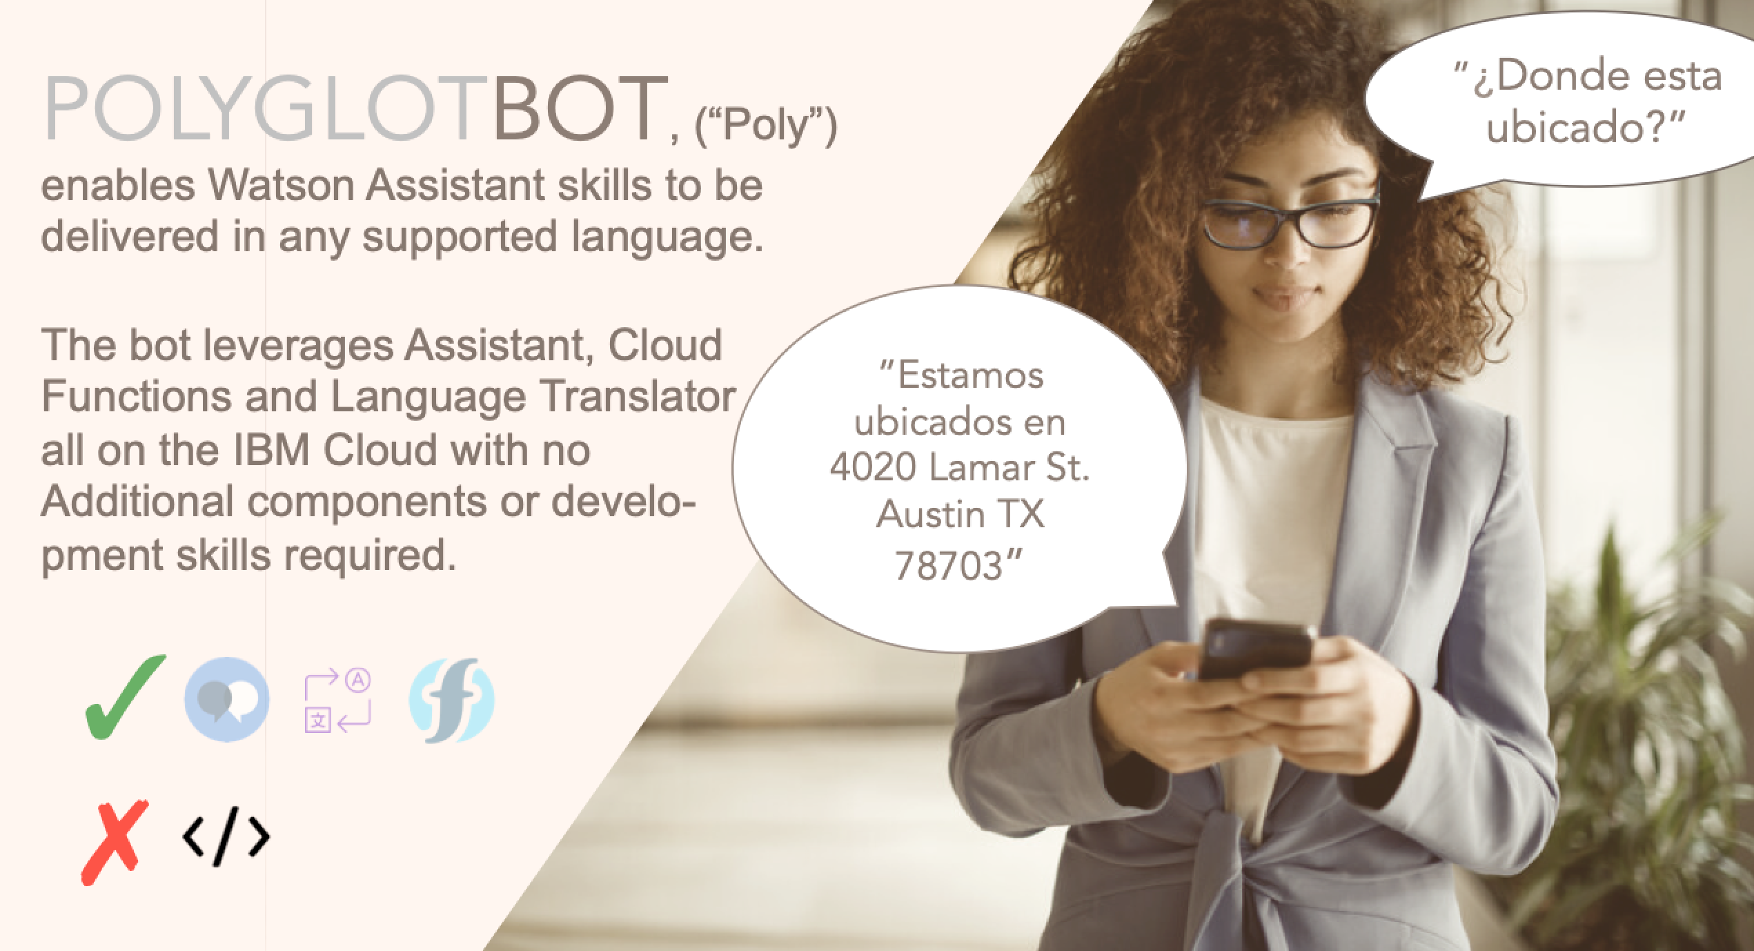

Slide 3


Flow Diagram, Language Orchestration
USER
WATSON ASSISTANT
FUNCTIONS
LANGUAGE TRANSLATOR
Start
Initiates Session
Present Language Choice
Choose language
Set @language entity
Welcome utterance
User utterance
@language triggers Web-hook, passes utterance to CF
Send utterance for English translation
Translate to English and return
Receive utterance and respond
Send English translation to WA
Send utterance for user language translation
Translate to Users language & return
Response in user language
Receive Webhook response
Send translation to WA
Notes:
User Initiates session
WA skill presents user with welcome and language choice
User identifies langugae, in this case Spanish
language Context Variable(CV) get set to “ES”
WA presents user with language appropriate introduction
User submits utterance
Dialog node triggered from CV, sends utterance to Cloud Function (CF)
Cloud Function
Send user utterance to Language Translation for translation to English
Language translation completes translation and returns it.
Receive english translation and Send translated user utterance to skill with english CV
WA Receives utterance and responds
Take response and send to LT for translation to Spanish and receive response
Send response in Spanish back to WA
WA response to user

Slide 4
Flow Diagram, Language Orchestration: Example
USER
WATSON ASSISTANT
FUNCTIONS
LANGUAGE TRANSLATOR
”¿Donde esta ubicado?”
¿Donde esta ubicado?
=
Where are you located?
We are located at 4020 Lamar St, Austin TX 78703
”Estamos ubicados en 4020 Lamar St. Austin TX 78703”
We are located at 4020 Lamar St, Austin TX 78703
=
Estamos ubicados en 4020 Lamar St. Austin TX 78703
Session A
Session B
Notes:
User Initiates session
WA skill presents user with welcome and language choice
User identifies langugae, in this case Spanish
language Context Variable(CV) get set to “ES”
WA presents user with language appropriate introduction
User submits utterance
Dialog node triggered from CV, sends utterance to Cloud Function (CF)
Cloud Function
Send user utterance to Language Translation for translation to English
Language translation completes translation and returns it.
Receive english translation and Send translated user utterance to skill with english CV
WA Receives utterance and responds
Take response and send to LT for translation to Spanish and receive response
Send response in Spanish back to WA
WA response to user

Slide 5
Language Orchestration Component Diagram
Pattern A: Single Skill
USER
SINGLE WA SKILL
CLOUD FUNCTION
LT INSTANCE
Session A
Session B
Notes:
Vessel
User Initiates session
WA skill presents user with welcome and language choice
User identifies langugae, in this case Spanish
language Context Variable(CV) get set to “ES”
WA presents user with language appropriate introduction
User submits utterance
Dialog node triggered from CV, sends utterance to Cloud Function (CF)
Cloud Function
Send user utterance to Language Translation for translation to English
Language translation completes translation and returns it.
Receive english translation and Send translated user utterance to skill with english CV
WA Receives utterance and responds
Take response and send to LT for translation to Spanish and receive response
Send response in Spanish back to WA
WA response to user

Slide 6
Language Orchestration Component Diagram
Pattern B: Multi Skill
USER
WA SKILL
CLOUD FUNCTION
LT INSTANCE
TARGET SKILL 1.
TARGET SKILL 2.
TARGET SKILL …
Session A
Session B
Notes:
Vessel, Nested session,
User Initiates session
WA skill presents user with welcome and language choice
User identifies langugae, in this case Spanish
language Context Variable(CV) get set to “ES”
WA presents user with language appropriate introduction
User submits utterance
Dialog node triggered from CV, sends utterance to Cloud Function (CF)
Cloud Function
Send user utterance to Language Translation for translation to English
Language translation completes translation and returns it.
Receive english translation and Send translated user utterance to skill with english CV
WA Receives utterance and responds
Take response and send to LT for translation to Spanish and receive response
Send response in Spanish back to WA
WA response to user

Slide 7
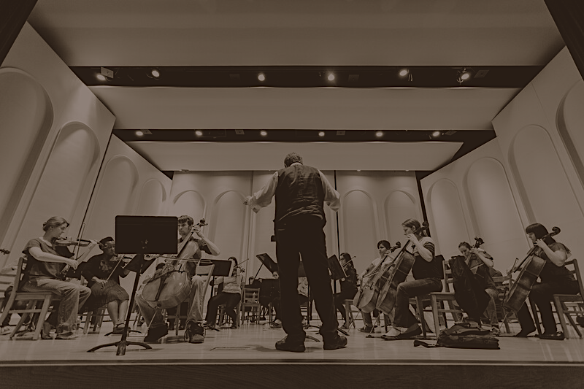
SKILLLORCHESTRATION
Connect multiple Skills with Cloud Functionsb

Slide 8
Skill Orchestration Component Diagram
Pattern A: Single Skill
USER
WA SKILL
CLOUD FUNCTION
TARGET SKILL
Session A
Session B
Notes:
Vessel, Nested session,
User Initiates session
WA skill presents user with welcome and language choice
User identifies langugae, in this case Spanish
language Context Variable(CV) get set to “ES”
WA presents user with language appropriate introduction
User submits utterance
Dialog node triggered from CV, sends utterance to Cloud Function (CF)
Cloud Function
Send user utterance to Language Translation for translation to English
Language translation completes translation and returns it.
Receive english translation and Send translated user utterance to skill with english CV
WA Receives utterance and responds
Take response and send to LT for translation to Spanish and receive response
Send response in Spanish back to WA
WA response to user

Slide 9
Skill Orchestration Component Diagram
Pattern B: Multi Skill
TARGET SKILL 1.
USER
WA SKILL
CLOUD FUNCTION
TARGET SKILL 2.
TARGET SKILL …
Session A
Session B
Notes:
Vessel, Nested session,
User Initiates session
WA skill presents user with welcome and language choice
User identifies langugae, in this case Spanish
language Context Variable(CV) get set to “ES”
WA presents user with language appropriate introduction
User submits utterance
Dialog node triggered from CV, sends utterance to Cloud Function (CF)
Cloud Function
Send user utterance to Language Translation for translation to English
Language translation completes translation and returns it.
Receive english translation and Send translated user utterance to skill with english CV
WA Receives utterance and responds
Take response and send to LT for translation to Spanish and receive response
Send response in Spanish back to WA
WA response to user

